Slide 1
Different patterns in Algorithm
Sequential
Sequential structure executes the program in the order in which they appear in the program
Selectional (conditional-branching)
Selection structure control the flow of statement execution based on some condition
Iterational (Loops)
Iterational structures are used when part of the program is to be executed several times

Slide 2
Sequential Pattern
Example1: Find the average runs scored by a batsman in 4 matches
Algorithm:
Step 1: Start
Step 2: Input 4 scores say runs1,runs2,runs3 and runs4
Step 3: Accumulate runs1,runs2,run3,and runs4 and store it
in the variable called total_runs
Step 4: Divide total_runs by 4 and find the average
Step 5: Display the average
Step 6: Stop

Slide 3
Flowchart
Start
Read run1, run2, run3, run4
total_run=run1+run2+run3+run4)
batting_average= total_run/4
display batting average
Stop

Slide 4
Pseudo code:
Begin
read run1,run2,run3 and run4
compute total_run= run1+run2+run3+run4
compute batting_average= total_run/4
display batting_average
end

Slide 5
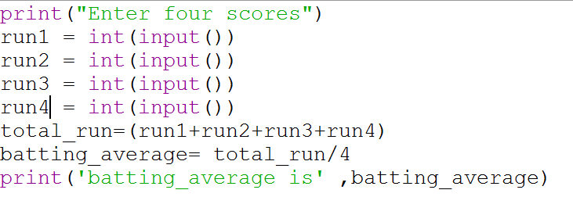
Batting Average

Slide 6
Area of a circle
Step 1 : Start
Step 2: Get the input for RADIUS
Step 3 : Find the square of RADIUS and store it in SQUARE
Step 4 : Multiply SQUARE with 3.14 and store the result in AREA
Step 5: Stop

Slide 7
Flowchart
Start
Accept radius
square = radius × radius
area= 3.14 × square
display area
Stop

Slide 8
Pseudo code:
begin
accept radius
compute square = radius * radius
compute area = pi * square
display area
end

Slide 9
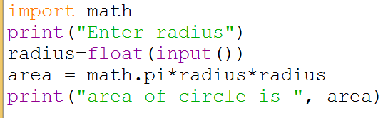
Area of a circle

Slide 10
Exercise
An university is setting up a new lab at their premises. Design an algorithm and write Python code to determine the approximate cost to be spent for setting up the lab. Cost for setting the lab is sum of cost of computers, cost of furnitures and labour cost. Use the following formulae for solving the problem:
Cost of computer = cost of one computer * number of computers
Cost of furniture = Number of tables * cost of one table + number of chairs * cost of one chair
Labour cost = number of hours worked * wages per hour

Slide 11
Budget for Lab
Input | Processing | Output
cost of one computer, number of computers, number of tables, cost of one table, number of chairs, cost of one chair, number of hours worked, wages per hour | Budget = Cost of computers + cost of furniture + labour cost Cost of computer = cost of one computer * number of computers Cost of furniture = Number of tables * cost of one table + number of chairs * cost of one chair Labour cost = number of hours worked * wages per hour | Budget for Lab

Slide 12
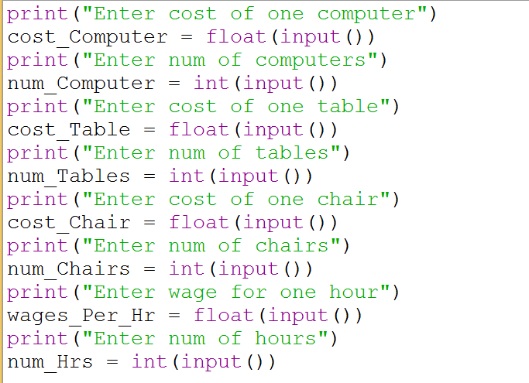
Python Program

Slide 13
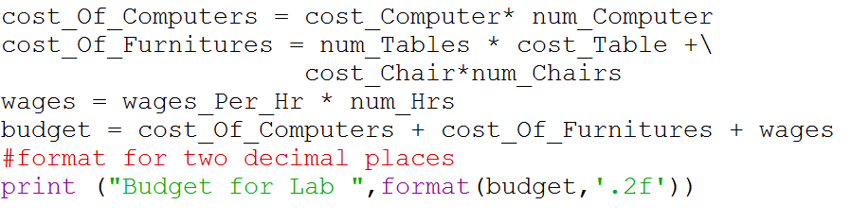
Python Program

Slide 14
Browsing Problem
Given the number of hours and minutes browsed, write a program to calculate bill for Internet Browsing in a browsing center. The conditions are given below.
(a) 1 Hour Rs.50
(b) 1 minute Re. 1
(c) Rs. 200 for five hours
Boundary condition: User can only browse for a maximum of 7 hours
Check boundary conditions

Slide 15
Browsing Program
Input | Processing | Output
Number of hours and minutes browsed | Check number of hours browsed, if it is greater than 5 then add Rs 200 to amount for five hours and subtract 5 from hours Add Rs for each hour and Re 1 for each minute Basic process involved: Multiplication and addition | Amount to be paid

Slide 16
Pseudocode
READ hours and minutes
SET amount = 0
IF hours >=5 then
CALCULATE amount as amount + 200
COMPUTE hours as hours – 5
END IF
COMPUTE amount as amount + hours * 50
COMPUTE amount as amount + minutes * 1
PRINT amount

Slide 17
Test Cases
Input
Hours = 6
Minutes = 21
Output
Amount = 271
Processing Involved
Amount = 200 for first five hours
50 for sixth hour
21 for each minute

Slide 18
Test Cases
Input
Hours = 8
Minutes = 21
Output
Invalid input
Processing Involved
Boundary conditions are violated

Slide 19
Already Know
To read values from user
Write arithmetic expressions in Python
Print values in a formatted way

Slide 20
Yet to learn
Check a condition

Slide 21
Selection pattern
A selection control statement is a control statement providing selective execution of instructions.

Slide 22
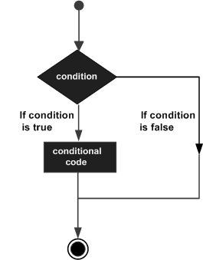
Control flow of decision making

Slide 23
If Statement
An if statement is a selection control statement based on the value of a given Boolean expression. The if statement in Python is
If statement | Example use
If condition: statements else: statements | If grade >=70: print(‘pass’) else: Print(‘fail’)

Slide 24
If Statement
If statement | Example use
If condition: statements else: statements | If grade >=70: print(‘pass’) else: Print(‘fail’)

Slide 25
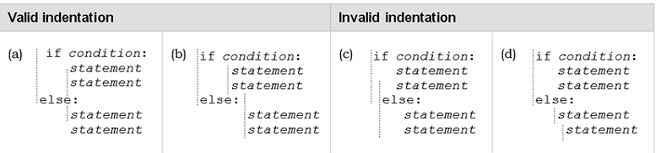
Indentation in Python
One fairly unique aspect of Python is that the amount of indentation of each program line is significant.
In Python indentation is used to associate and group statements

Slide 26
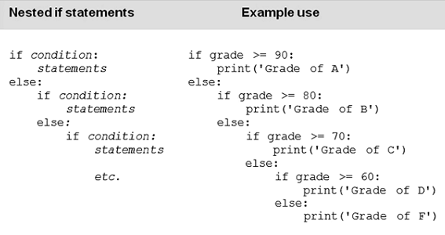
Nested if Statements
There are often times when selection among more than two sets of statements (suites) is needed.
For such situations, if statements can be nested, resulting in multi-way selection.

Slide 27
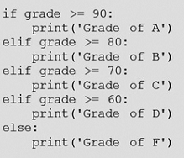
Else if Ladder

Slide 28
Multiple Conditions
Multiple conditions can be check in a ‘if’ statement using logical operators ‘and’ and ‘or’.
Python code to print ‘excellent’ if mark1 and mark2 is greater than or equal to 90, print ‘good’ if mark1 or mark2 is greater than or equal to 90, print ‘need to improve’ if both mark1 and mark2 are lesser than 90

Slide 29
if mark1>=90 and mark2 >= 90:
print(‘excellent’)
if mark1>=90 or mark2 >= 90:
print(‘good’)
else:
print(‘needs to improve’)

Slide 30
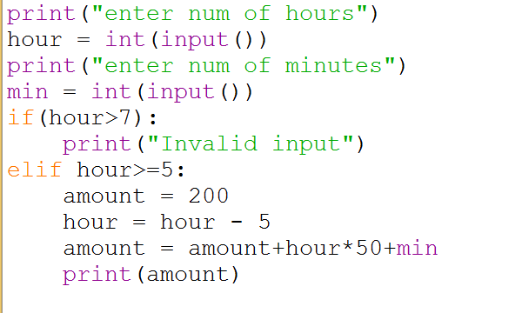
Browsing Program

Slide 31
Eligibility for Scholarship
Government of India has decided to give scholarship for students who are first graduates in family and have scored average > 98 in math, physics and chemistry. Design an algorithm and write a Python program to check if a student is eligible for scholarship
Boundary Conditions: All marks should be >0

Slide 32
Scholarship Program
Input | Processing | Output
Read first graduate, physcis, chemistry and maths marks | Compute total = phy mark + che mark + math mark Average = total/3 Check if the student is first graduate and average >=98 | Print either candidate qualified for Scholarship or candidate not qualified for Scholarship

Slide 33
Algorithm
Step 1 : Start
Step 2: Read first graduate, physcis,chemistry and maths marks
Step 3: If anyone of the mark is less than 0 then print ‘invalid input’ and terminate execution
Step 3 : Accumulate all the marks and store it in Total
Step 4 : Divide Total by 3 and store it in Average
Step 5 : If student is first graduate Average score is greater than or equal to 98 then print candidate qualified for Scholarship
Else
Print candidate not qualified for scholarship
Stop 6: Stop

Slide 34
Test Cases
Input
First graduate = 1 Phy mark = 98, Che mark = 99, math mark = 98
Output
candidate qualified for Scholarship
Processing Involved
Total = 295
Average = 98.33
Student is first graduate and average > 98

Slide 35
Test Cases
Input
First graduate = 0 Phy mark = 98, Che mark = 99, math mark = 98
Output
candidate is not qualified for Scholarship
Processing Involved
Total = 295
Average = 98.33
Student is not first graduate but average > 98

Slide 36
Test Cases
Input
First graduate = 1 Phy mark = 98, Che mark = 99, math mark = 90
Output
candidate is not qualified for Scholarship
Processing Involved
Total = 287
Average = 95.67
Student is first graduate but average < 98

Slide 37
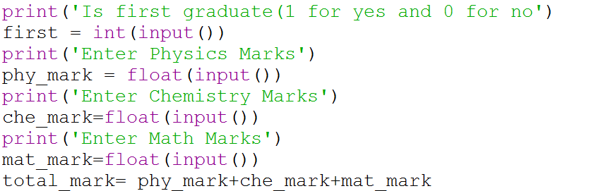

Slide 38
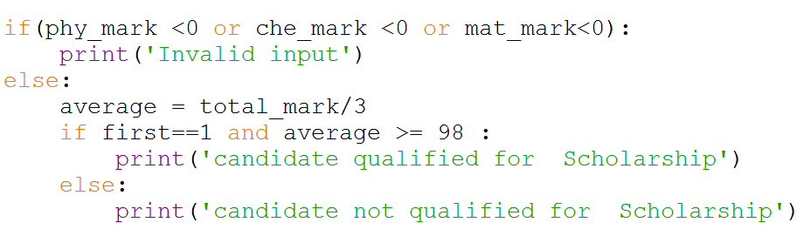

Slide 39
Algorithm for Largest of Three numbers
Step1: Start
Step2: Read value of a, b and c
Step3: If a is greater than b then
compare a with c and if a is bigger then say a is biggest else say c is biggest
else Compare b with c , if b is greater than c say b is biggest else c is biggest
Step 5: Stop

Slide 40
Flowchart
Start
Accept a,b and c
Y
display a is bigger
Is
a>b
Y
Is
a>c
N
N
Is
b>c
N
display c is bigger
Y
display b is bigger
Stop

Slide 41
Test Cases
Input
a = 12, b = 13, c = 14
Output
c is greatest
Processing Involved
B is greater than a but c is greater than b

Slide 42
Test Cases
Input
a = 13, b = 12, c = 14
Output
c is greatest
Processing Involved
a is greater than b but c is greater than a

Slide 43
Test Cases
Input
a = 13, b = 2, c = 4
Output
a is greatest
Processing Involved
a is greater than b and a is greater than c

Slide 44
Test Cases
Input
a = 3, b = 12, c = 4
Output
b is greatest
Processing Involved
b is greater than a and b is greater than c

Slide 45
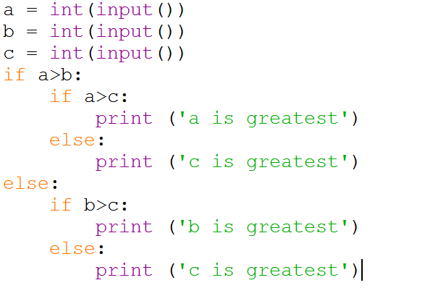

Slide 46
The if/else Ternary Expression
Consider the following statement, which sets A to either Y or Z, based on the truth value of X:
if X:
A = Y
else:
A = Z
new expression format that allows us to say the same thing in one expression:

Slide 47
A = Y if X else Z

Slide 48
>>> A = 't' if 'spam' else 'f'
>>> A
't'
>>> A = 't' if '' else 'f'
>>> A
'f'

Slide 49
Exercise Problem
Write a python code to check whether a given number of odd or even?
Write a python code to check whether a given year is leap year or not?
Write a python code in finding the roots of a quadratic equation?
Write a python program to segregate student based on their CGPA. The details are as follows:
<=9 CGPA <=10 - outstanding
<=8 CGPA <9 - excellent
<=7 CGPA <8 - good
<=6 CGPA <7 - average
<=5 CGPA <6 - better
CGPA<5 - poor

